Slide 1
AI in Game Development
Dr. Mousavi – Shiraz University
By Hossain Khademian – Summer 2021

Slide 2
Definitions

Slide 3
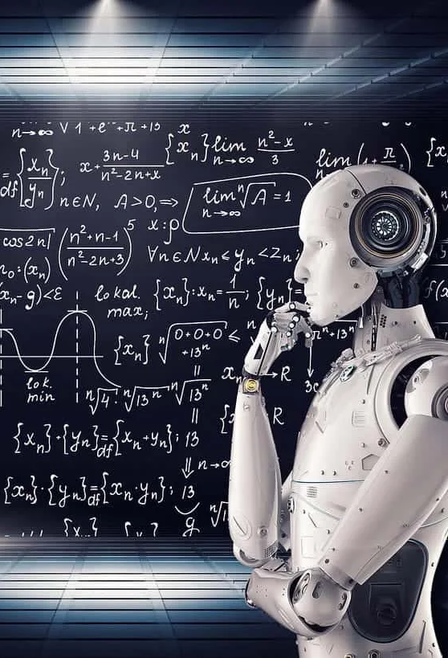
Artificial Intelligence
As opposed to the Natural Intelligence displayed by humans or animals which have real mind to make decisions.
AI is intelligence demonstrated by machines.
There are some general algorithms and problem specific algorithms like Search , CSP , …

Slide 4

Machine Learning
Machine learning is a branch of AI
Focuses on Imitate the way that humans learn
gradually improving its accuracy
Heavily use data to learn about problem and improve
Make predicts and decision upon them based decision tree on what it learned past
See: https://youtu.be/l4Ye70M3rZU

Slide 5
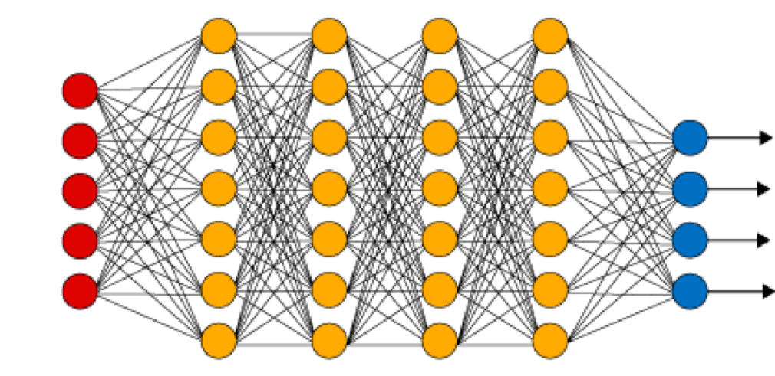
Deep Learning
part of machine learning
inspired by our brain and the connection between neurons
Most use neural network architecture
"deep" in reference to the layers that these neural networks have
Used in Computer Vision and Speech Recognition

Slide 6
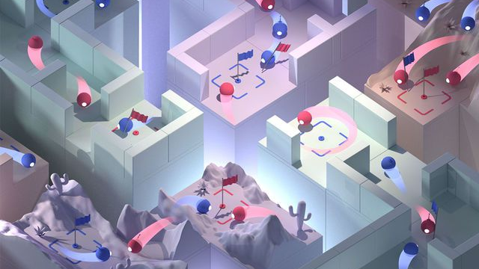
AI for Games
AI for C.S. is Different for Games
Challenging Opponents - Helpful Allies
Often constrained by game rules
Must be smart, but purposely flawed
Loose in a fun, challenging way
Must perform in real time (CPU)
Configurable by designers
Not hard coded by programmer

Slide 7
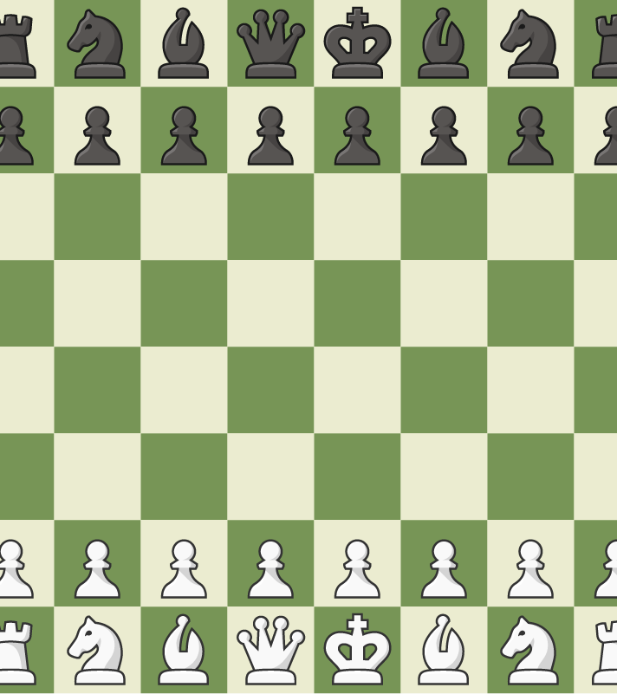
Agents in Games
Every individual entity in game which can decide what to do , in scope of game Mechanics.
They can act independent or Cooperate to do some task toward goals developer or player assign for them.
Like your opponent in Chess

Slide 8
Agents
Sense
Act
Think
Most AI focuses around game agent
think of agent as NPC, enemy, ally or neutral
Loops through: sense , think, act cycle
Acting is event specific:
first sense and think then act

Slide 9
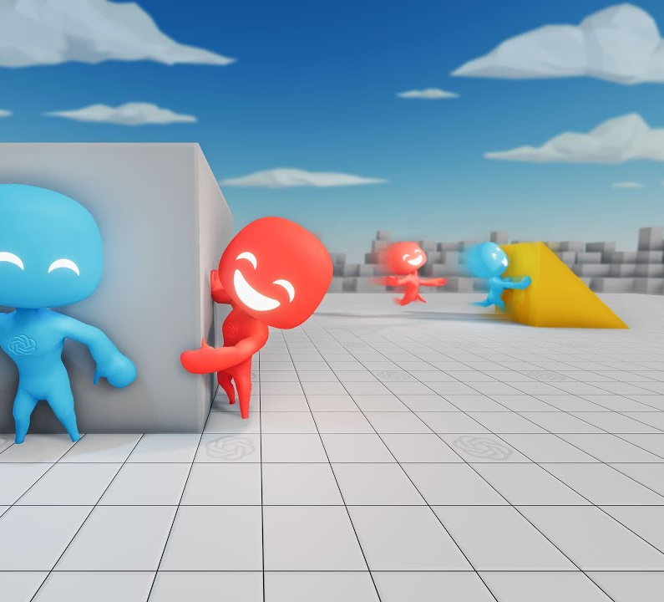
Game Agents Sensing
Gather current world state: barriers, opponents, objects
Needs limitations: avoid cheating by looking at game data
Typically, same constraints as player (vision, hearing range, etc.)

Slide 10
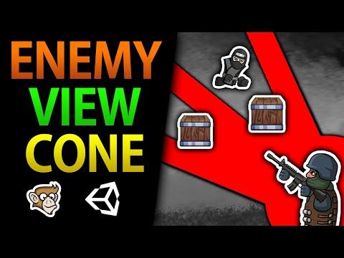
Sense - Vision
Quite complicated to test visibility
Compute vector to each object
magnitude (is it too far away?)
Check angle (dot product) (within 120° viewing angle?)
Check if obscured (Most expensive: so do last)
https://youtu.be/3-jPo2wzvdw

Slide 11
Sense
Hearing
Example:
tip-toe past, enemy doesn’t hear
run past, enemy hears
Implement as event-driven
When player performs action
notify agents within range
Communication
Sensing data from other agents
instant (connected by radio)
hearing (loud shout)
Reaction times
Sensing may take some time
Build in delay Implement (simple timers)

Slide 12
Game Agents Thinking
Evaluate information
Make decision
Pre-coded expert knowledge
Typically hand-crafted “if-then” rules
+ “randomness” to make unpredictable
Search algorithm for best (optimal) solution (MinMax, MinConflict, ...)

Slide 13
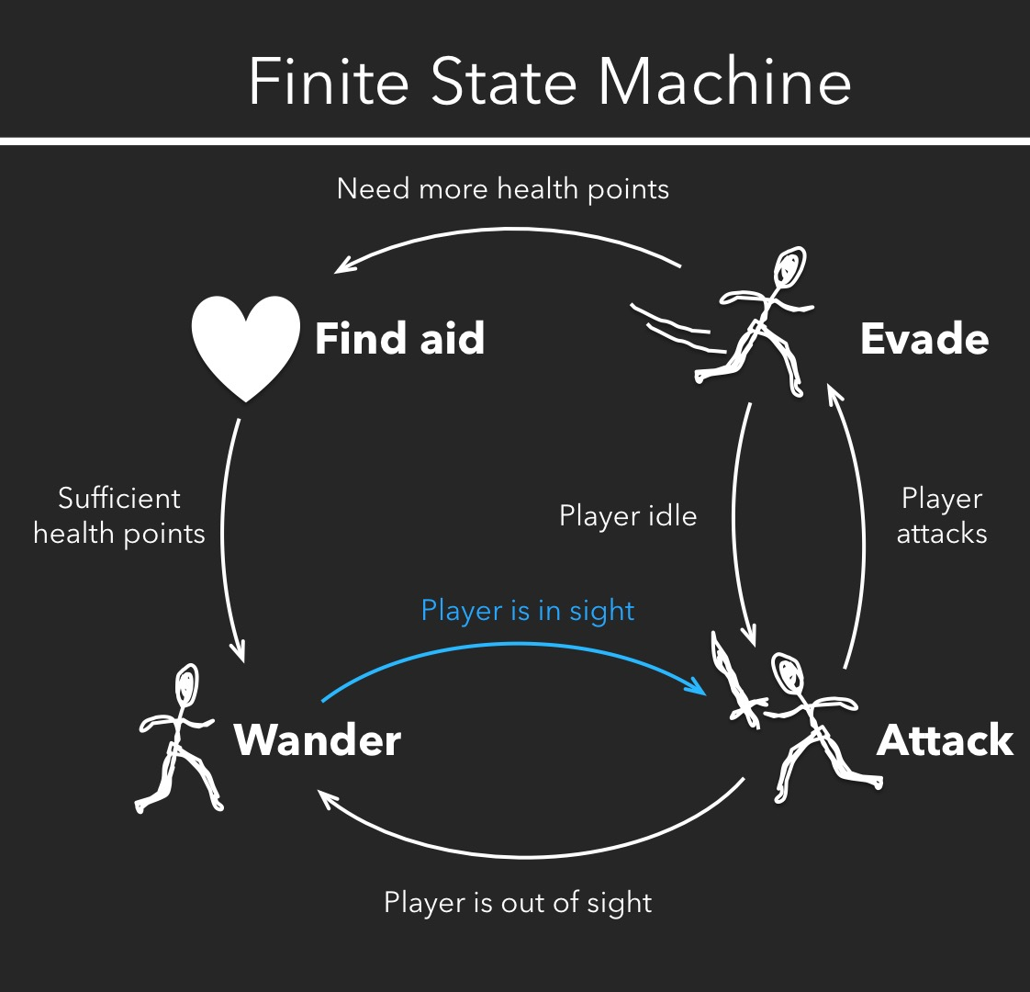
Thinking Finite State Machines
FSM most popular . Appealing since:
simple, natural, embodies common sense and knowledge of domain
Ex: See enemy weaker than you? -> Attack. See enemy stronger? -> Go get help
But does not scale
Complex situations have many factors
Add more rules, becomes brittle
Suitable for many AI tasks:
Many agents have quite narrow domain
See: https://www.kidscodecs.com/finite-state-machine-games/

Slide 14
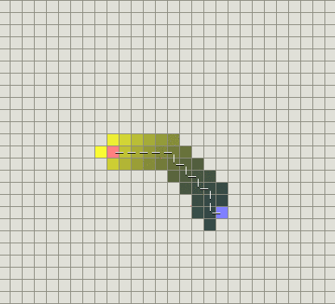
Thinking Search
Look ahead and see what move to do next
Ex: piece on game board (MinMax , MinConflict, ...) , pathfinding (A* , hueristic)
Works well with known information
can see obstacles, pieces on board, path finding, …
Collect Knoledge about environment and query when needed (Resolution , …)

Slide 15
Thinking Machine learning
Evaluate past actions, use for future action
Even we can train Agents in Game Development and use in Production as Mutate Agent
Learning process is too slow and costly
Required large investments in development to buy equipments and hire technitions to run tests and players to learn from

Slide 16
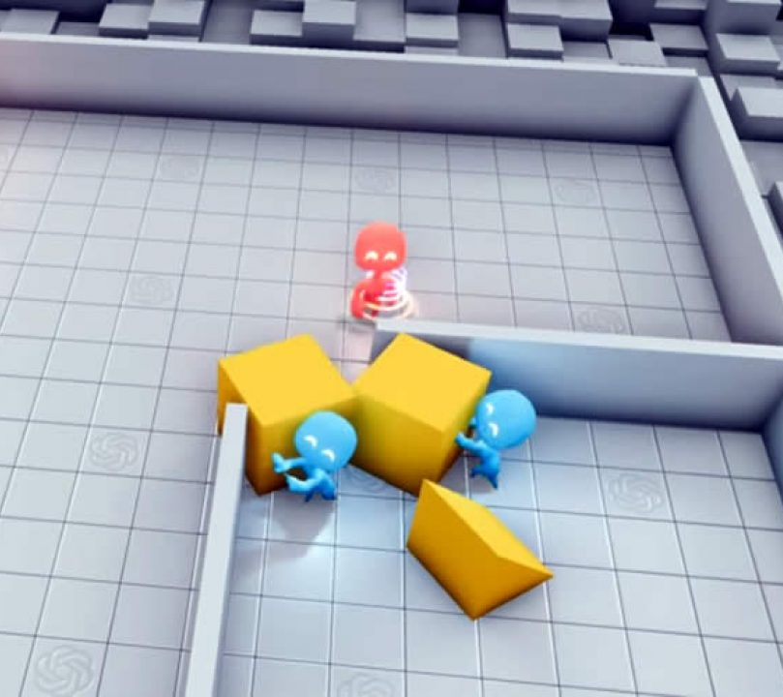
Game Agents – Acting
Learning and Remembering
Not important in agent short-lived (enemy drone)
Helpful if alive for 30+ seconds
(player attacks from right, so shield right)
Implementation, too avoid too much information:
fade memory (time , overflow)

Slide 17
Game Agents Acting
Making agents stupid
Many cases, easy to make agents dominate
FPS bot always makes head-shot
Dumb down by giving “human” conditions
longer reaction times, make unnecessarily vulnerable, have make mistakes
Agent cheating
Ideally, don’t have unfair advantage
(such as more attributes or more knowledge)
may cheat to make a challenge

Slide 18
Algorithms
General and Problem Specific Solutions

Slide 19
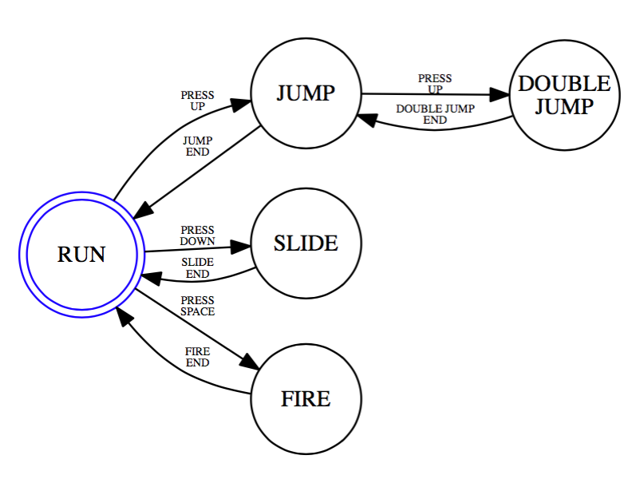
Finite State Machines
Abstract model of computation
Set of states
A starting state
An input vocabulary
A transition function that maps inputs and the current state to a next state
ResState := trans(CurState, inp)

Slide 20
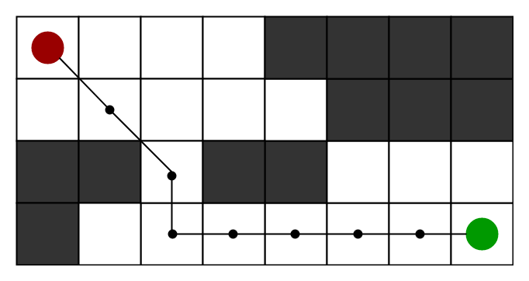
C.S. Search Algorithms
Convert problem states to a graph
Current State is start node
Each action is an edge from a node to other
Problem Goal (which we want to reach) is Graph's final State
There is two kind:
Blind (UnInformed about next state) :
DFS, BFS, Iterative-Deeping
Informed (can guess what is in the next state)
Heuristic , A* , …
SEE:
https://qiao.github.io/PathFinding.js/visual/

Slide 21
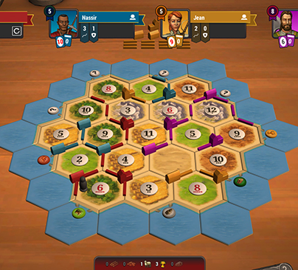
MiniMax
Heart of board game
Applies to games where:
Players take turns
Have perfect information
Chess, Checkers, Tactics
can work with chance or without perfect information:
- Poker, Monopoly, Dice

Slide 22
Top References
https://www.ibm.com/cloud/learn/machine-learning
https://blog.bismart.com/en/difference-between-machine-learning-deep-learning
https://www.zdnet.com/article/what-is-ai-everything-you-need-to-know-about-artificial-intelligence/
https://en.wikipedia.org/wiki/Artificial_intelligence

